Slide 1
Analyzing Credit Card Customers
By Jier Miao

Slide 2
Introduction
Motivation: I got rejected three times from applying credit card, so I'm wondering the background about each credit card customers.
Goal: I want to find the association between their background and attribute the credit cards they have.

Slide 3
Gender - M=Male, F=Female
Dependt_count = Number of dependents
Education_level = Educational Qualification of the account holder (example: high school, college graduate, etc.)
Martital_statis = Married, Single, Divorced, Unknown
Income_category = Annual Income Category of the account holder (< $40K, $40K - 60K, $60K - $80K, $80K-$120K
Customer_age = age
Total_trans_amt = Total Transaction Amount

Slide 4
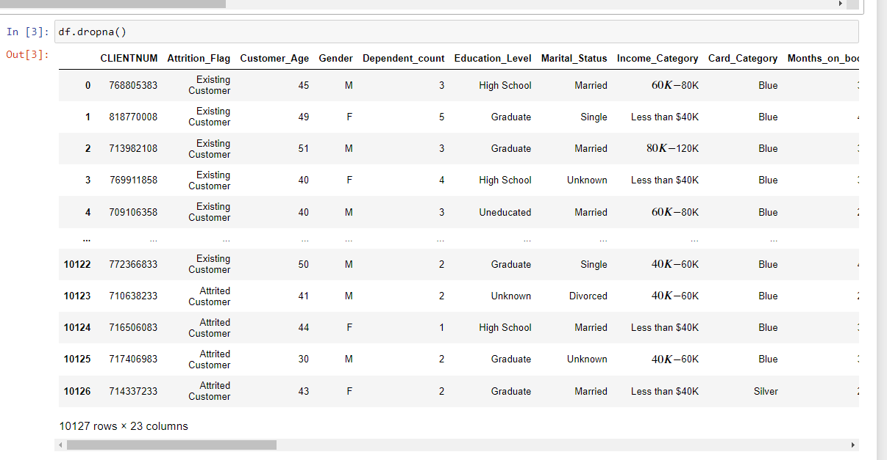
Data Set

Slide 5
Descriptive Analytics
What is the relationship between Education_Level and Credit_Limit and Marital_Status in this dataset?
For Descriptive Analytics research question set, I will first create a side-by-side boxplots that visualizes the relationship between Education_Level, Credit_Limit, and Marital_Status. Then I will use a groupby. describe to show the set of summary statistics.

Slide 6
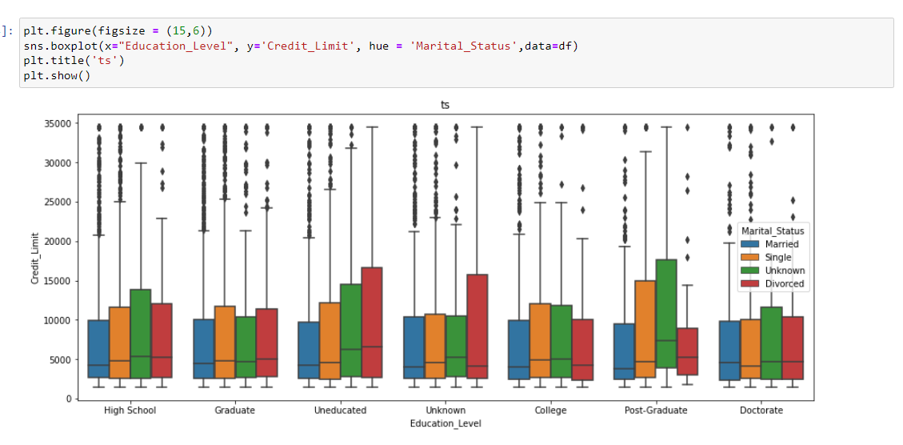
I found that the divoced people who are uneducated have the heighest credit limit, and the married people whoa are unedcated have the lowest credit limit.

Slide 7
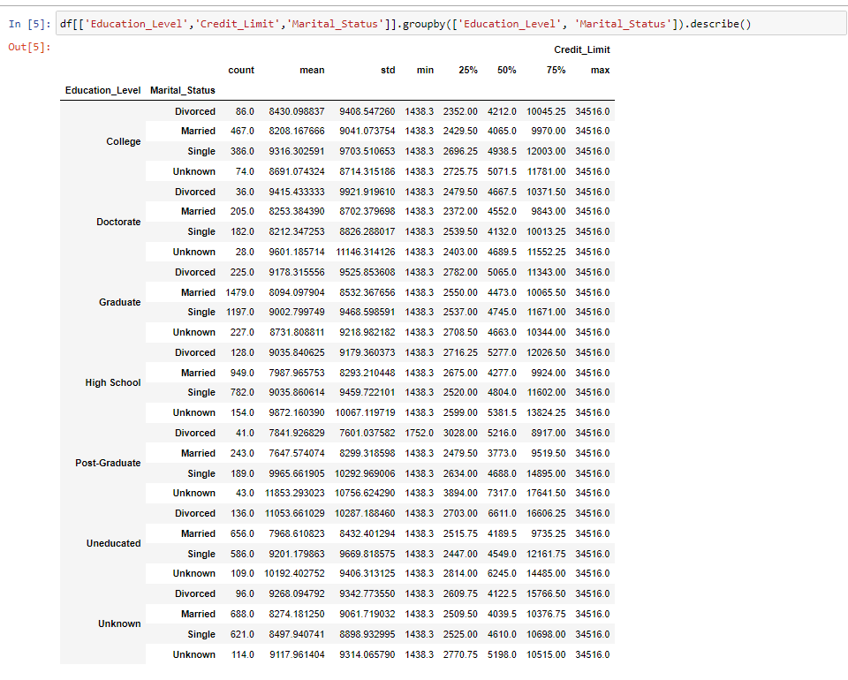
For people with college degrees, those who are single have the heighest mean of creidit limit, and the people who are married have the lowest mean of credit limit. For people with a graduate degreee, the people who are divorced have the heighest mean of credit limit, and the people who are married have the lowest mean of credit limit.

Slide 8
How they help me answer my research question?
Based on the plot and summary statistics, we found out that divorced people have a higher median and mean credit limit than people who are married. We also found out there is no significant relationship between uducational level and mean and median credit limit.

Slide 9
Inference
Is there an association between Education_Level and Avg_Open_To_Buy for credit card holders in America.
Evaluate these hypotheses using a p-value and 𝛼=0.05
For inference reserarch question, I'll set a condition and test the hyposthesis of whether 𝜇G−𝜇U equal or not equal to 0.𝜇G reperents the mean amount of credits left for use for the people who have college degree or higher and 𝜇U reperents the mean amount of credits left for use for the people who do not have a college degree.

Slide 10
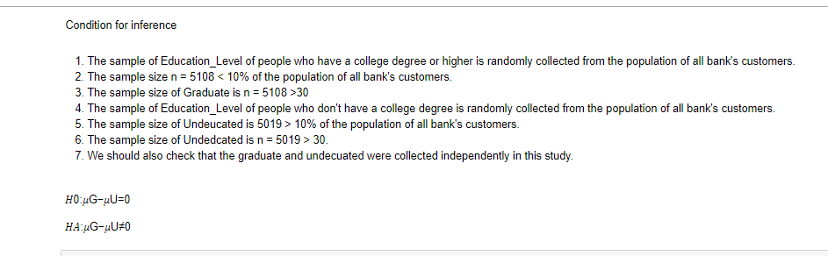
𝜇G reperents the mean amount of credits left for use for the people who have college degree or higher and 𝜇U reperents the mean amount of credits left for use for the people who do not have a college degree.

Slide 11
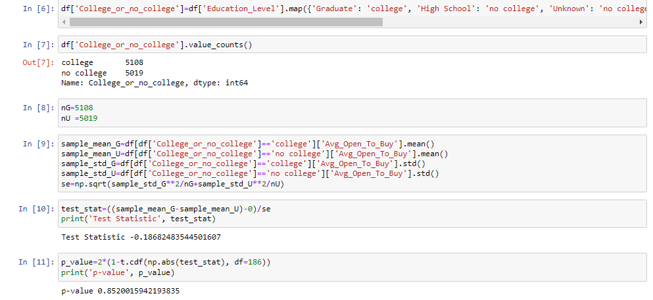
Because the 𝑝−𝑣𝑎𝑙𝑢𝑒≈0.9061736369388975>𝛼=.05 , we failed to reject the null hypothesis. Which means we don't have a sufficient evidence to suggest that there is an association between the average open level to buy of education level of people who have a college degree or higher and people who don't have a college degree in US

Slide 12
Linear Regression
Is there a linear relationship between credit limit and total_revolving_bal, total trans amount,income category, and gender in the sample
For linear regressopm research question set, I'll fit a model to check if there is a linear relationship between Credit_Limit and total_Revolving_Balance, Total_Trans_Amt, Income_Category, Gender.

Slide 13
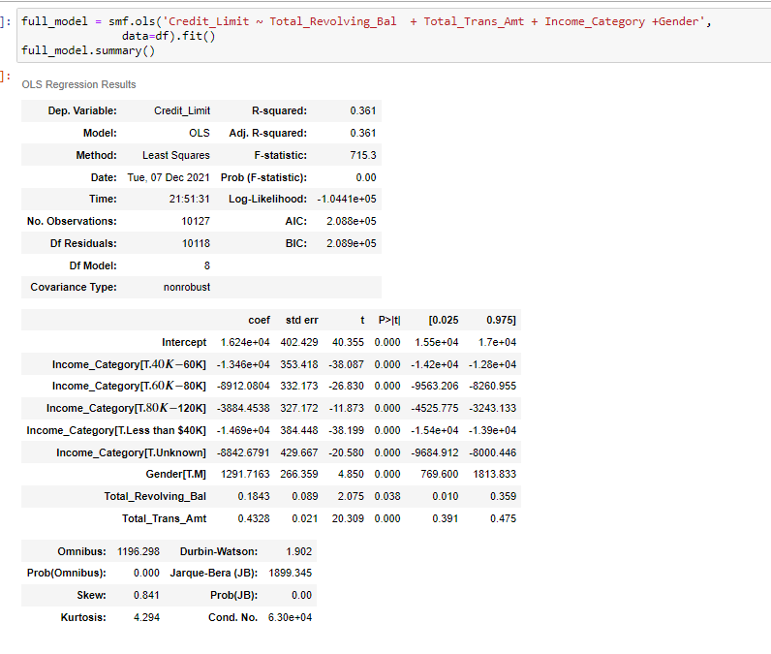

Slide 14
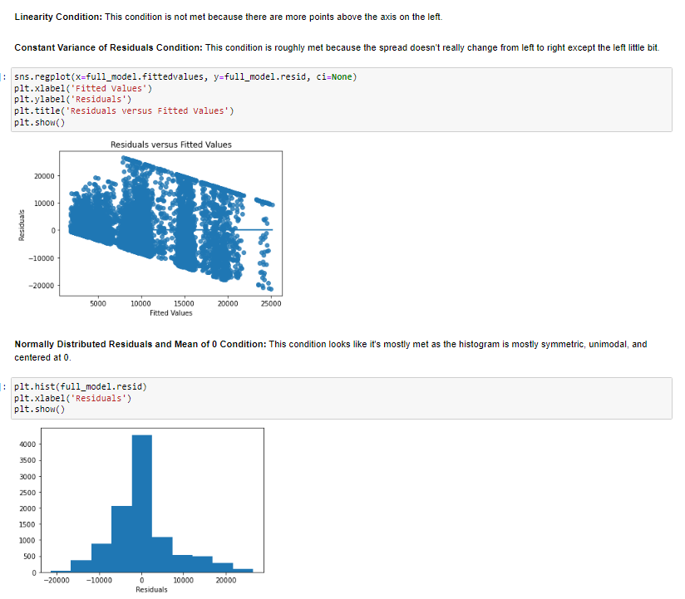

Slide 15
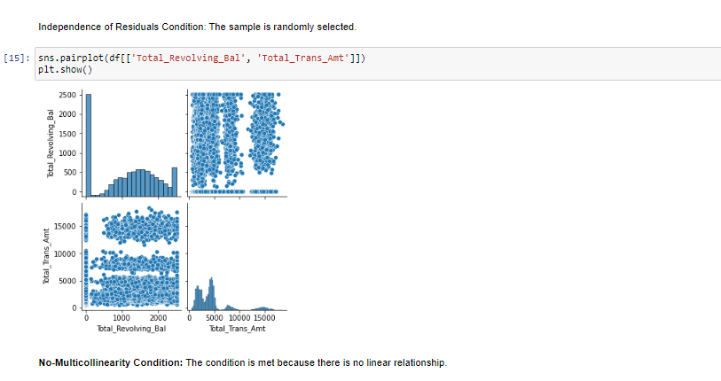

Slide 16

Equation

Slide 17
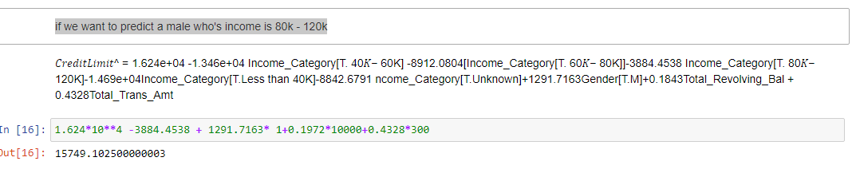
if we want to predict a male who's income is 80k - 120k

Slide 18
All my slopes are significant because all of my p-values are below 0.05 which means all of them are non-zero.
there is a linear relationship between credit limit and total_revolving_bal, total trans amount,income category, and gender in the sample.

Slide 19
Logistic Regression
we would like to build a model that will make accurate predictions for new datasets
For logistic regression research question set, I'll check if therse is a linear relationship between the log-odds of the success level of income category and Credit_Limit+Dependent_count+Total_Trans_Amt +Customer_Age. I'll also determined what varible should I include to build a parismonious model.

Slide 20
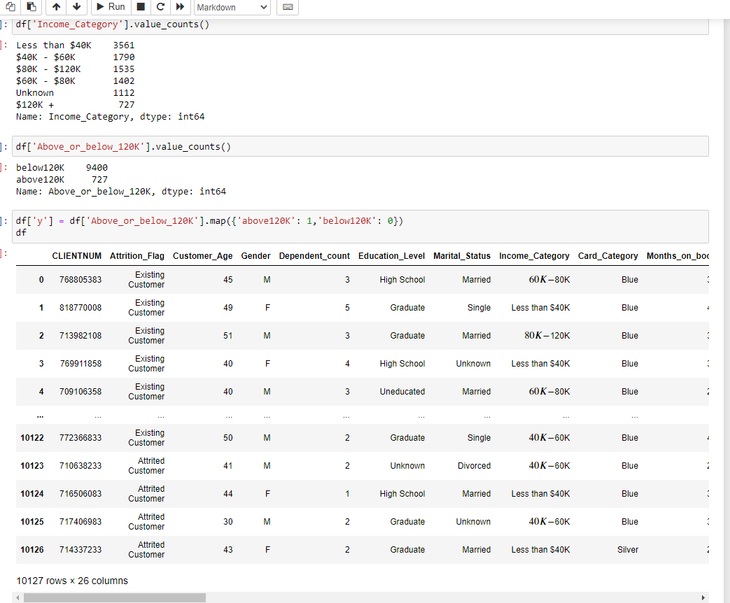
above 120k = 1
below 120k = 0

Slide 21
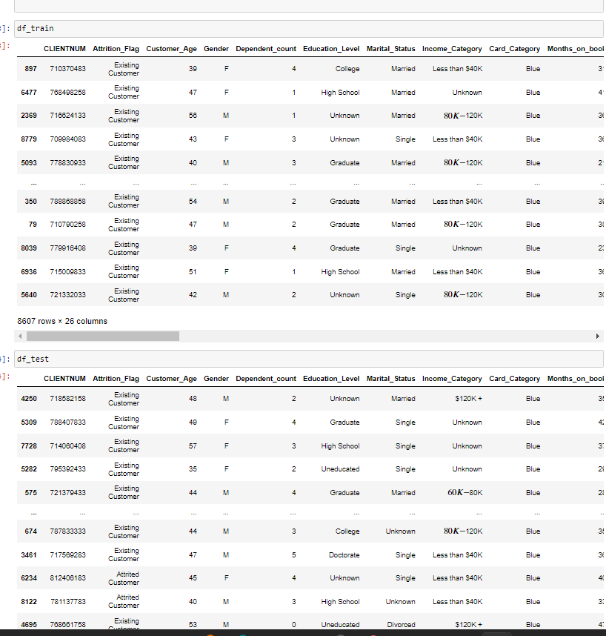
the training dataset is comprised of a random sample of 85% of the rows in our dataframe, the test dataset is comprised of the remaining 15% of rows in the dataframe, and we use a random state of 100.

Slide 22
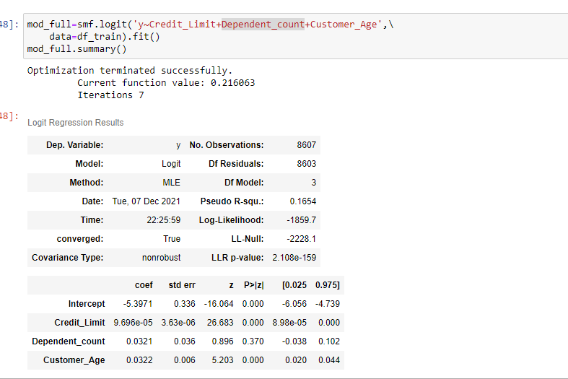
AIC
After doing AIC, our finalmodel is the current model which has deleted just Total_Trans_Amt.

Slide 23
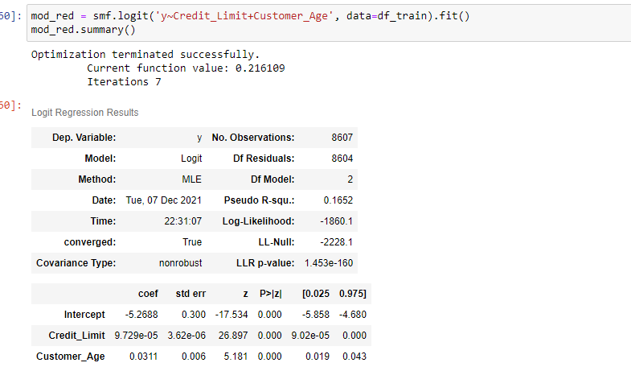
The slope of the Credit limit and customer age are significant because all of my p-values are below 0.05 which means all of them are non-zero.

Slide 24
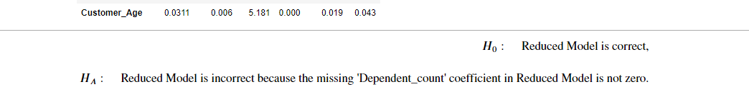

Slide 25
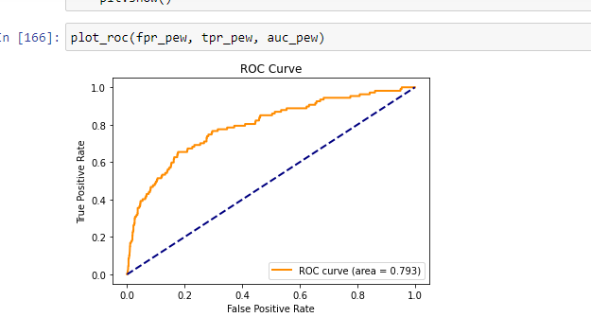
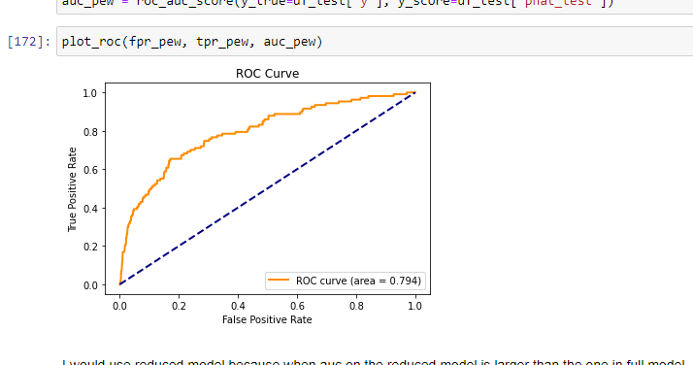

Slide 26
0.13 is the predictive probability threshold tgat will give me tpr = 0.495327, fpr = 0.102619, because the heighest tpr and lowest fpr has a good predictive probability threshold

Slide 27
Conclution
Based on the plot and summary statistics, we found out that divorced people have a higher median and mean credit limit than people who are married. We also found out there is no significant relationship between educational level and mean and median credit limit. We also found that we don't have sufficient evidence to suggest that there is an association between the average open level to buy or education level of people who have a college degree or higher and people who don't have a college degree in the US. We also found there is a linear relationship between credit limit and total_revolving_bal, total trans amount,income category, and gender in the sample.

Slide 28
Future work
If I were to conduct future work based on these analyses, I might want to learn more about what type of people can have a higher credit limit.

Slide 29
The end

